Slide 1
Conflict in Africa

Slide 3
Increased Interest in Africa.
Eventually diamonds and gold were discovered in South Africa.
This escalated European activity in Africa.
It also brought European nations to the brink of war over mineral rights.

Slide 4
The Berlin Conference.
Fearing war would break out in Europe, all the major powers sat down to discuss Africa.
The continent was divided up among the Europeans.
No African leaders were invited.

Slide 5
Cecil Rhodes
Head of the De Beers diamond company.
He was responsible for expanding British land in South Africa.
Wanted the British Empire to take over the world, starting with Africa.

Slide 6
"I contend that we are the finest race in the world and that the more of the world we inhabit the better it is for the human race."

Slide 7
Case Study: South Africa
South Africa is a good example of imperialism
The history of South Africa demonstrates the pros and cons of imperialism.

Slide 8
Dutch Arrival
The First Europeans in South Africa were the Dutch in the 1600s.
They established a colony in order to resupply ships to India
The Dutch established large farms on African land.

Slide 9
Boer Farmers.
The Dutch are often known as the Boers (Dutch for Farmers).
They are also sometimes called Afrikaners due to the language that evolved in Dutch South Africa called Afrikaans.
They tended to be intensely nationalistic, rural people.

Slide 10
British Takeover
When the British took over in the early 1800’s they clashed immediately with the Boers.
The British got rid of slavery in 1803, which infuriated the Boers.
Generally the British became very urbanized.

Slide 11
Zulu Expansion
The British had been kept on the coast by a powerful the Zulu king Shaka.
Just North of where the Europeans were, the Zulu were driving other tribes off their lands.
Shaka was killed, and the region became destabilized.

Slide 12
The Great Trek
The Boers tried to escape British rule by migrating north and east.
On their journey they found rich grazing land, with little or no people.

Slide 13
Boer Republics
The Boers decided that finding this rich new land was a gift from God, and formed new countries on it.
What they did not know was that the land was empty because the Zulu had just killed everyone on it.

Slide 14
Zulu Wars
Furious about European incursion into their newly conquered territory, the Zulu army swarmed the Boers at Ncome River.
The Zulu were not prepared for modern weapons.
Thousands of Zulu died, but not a single Boer was killed.

Slide 15
Anglo-Zulu Wars
Soon the British too had to face the Zulu army.
The Zulu became the only Africans to seriously challenge the Europeans.
After the British had crushed them, there was little resistance.

Slide 21
Gold Rush
When the Boers discovered even more gold and diamonds there was a massive influx of British prospectors.
These prospectors demanded rights, which the Boers refused to grant them.

Slide 22
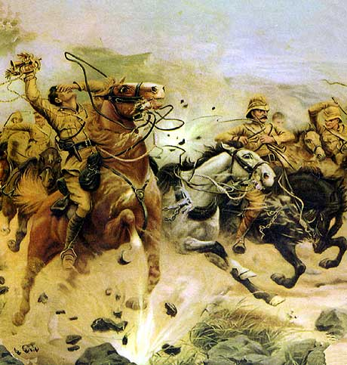
Boer Wars
Eventually all our war broke out between the British and the Boers.
The Boer wars were the first modern “total” wars.
They were the first to make use of commandos, and specifically target civilians on a large scale.

